Slide 1
Bank Personal Loan
Analysis of the best accuracy in the ANN model

Slide 2
The ANN model with highest accuracy was achieved using the following combinations
Activation Function: Tanh
Optimizer: SGD
Loss Function: Sparse Categorical Crossentropy
Hidden Layers: 1
Epochs: 100
Accuracy: 98.67
Loss: 0.049

Slide 3
Activation Function | Optimizer | Loss Function | Hidden Layers | Epochs | Accuracy | Screenshot
Sigmoid | SGD | Binary Crossentropy | 1 | 10 | 50% | Appendix 1
Relu | Adam | Binary Crossentropy | 2 | 100 | 50% | Appendix 2
Relu | Adam | Categorical Hinge | 2 | 10 | 2.27% | Appendix 3
Sigmoid | Adam | Sparse Categorical Crossentropy | 1 | 100 | 97.4% | Appendix 4
Relu | Adamax | Sparse Categorical Crossentropy | 1 | 100 | 98.6% | Appendix 5
Relu | Adam | Sparse Categorical Crossentropy | 1 | 100 | 98.4% | Appendix 6
Relu | SGD | Sparse Categorical Crossentropy | 1 | 100 | 97.06% | Appendix 7
Tanh | SGD | Sparse Categorical Crossentropy | 1 | 100 | 98.67% | Appendix 8
Tanh | Adam | Sparse Categorical Crossentropy | 1 | 100 | 98.53% | Appendix 9

Slide 4
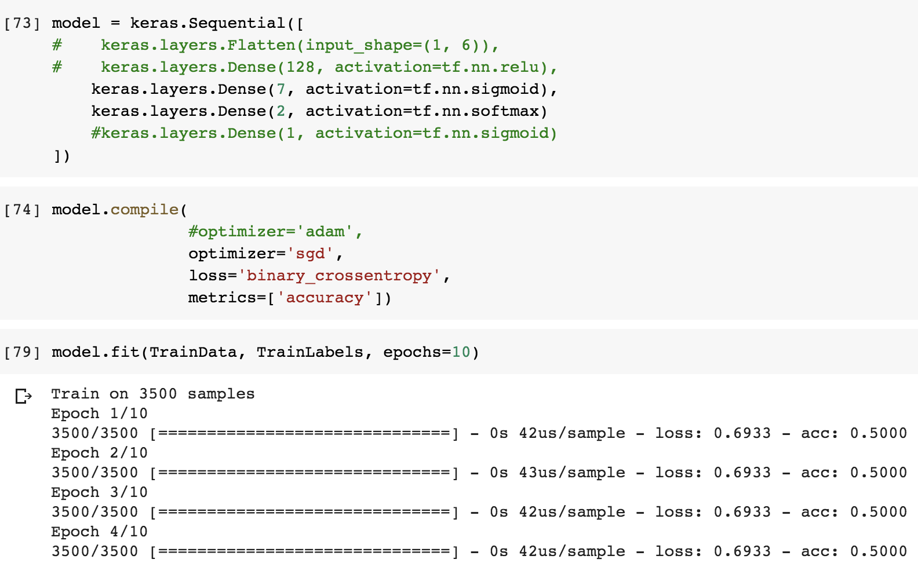
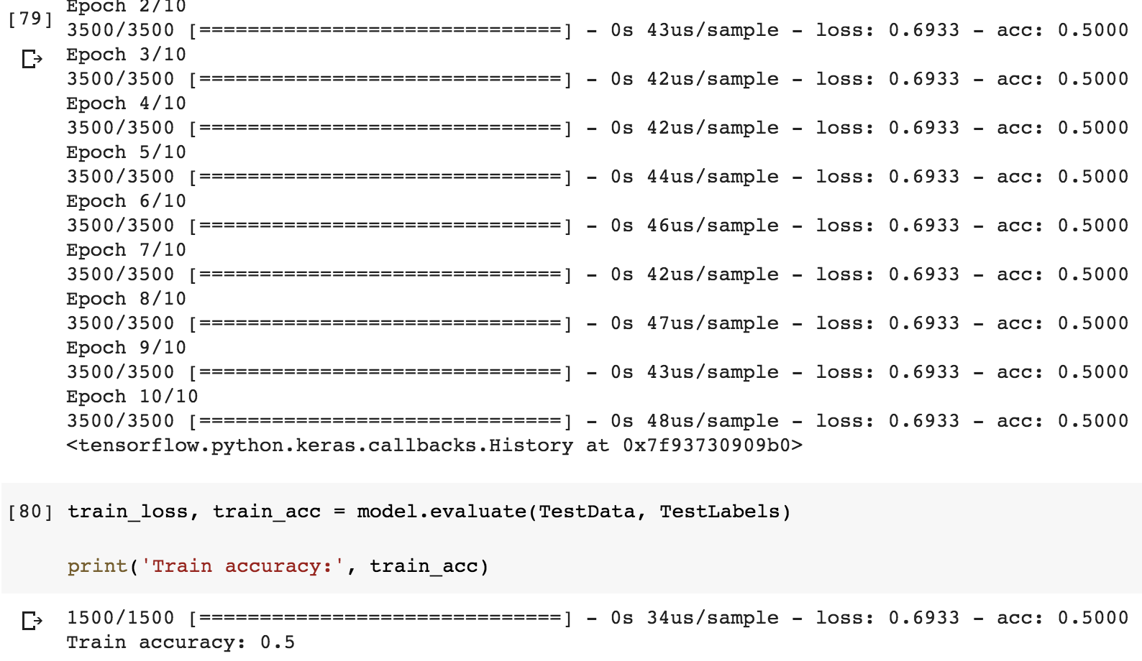
Appendix 1

Slide 5
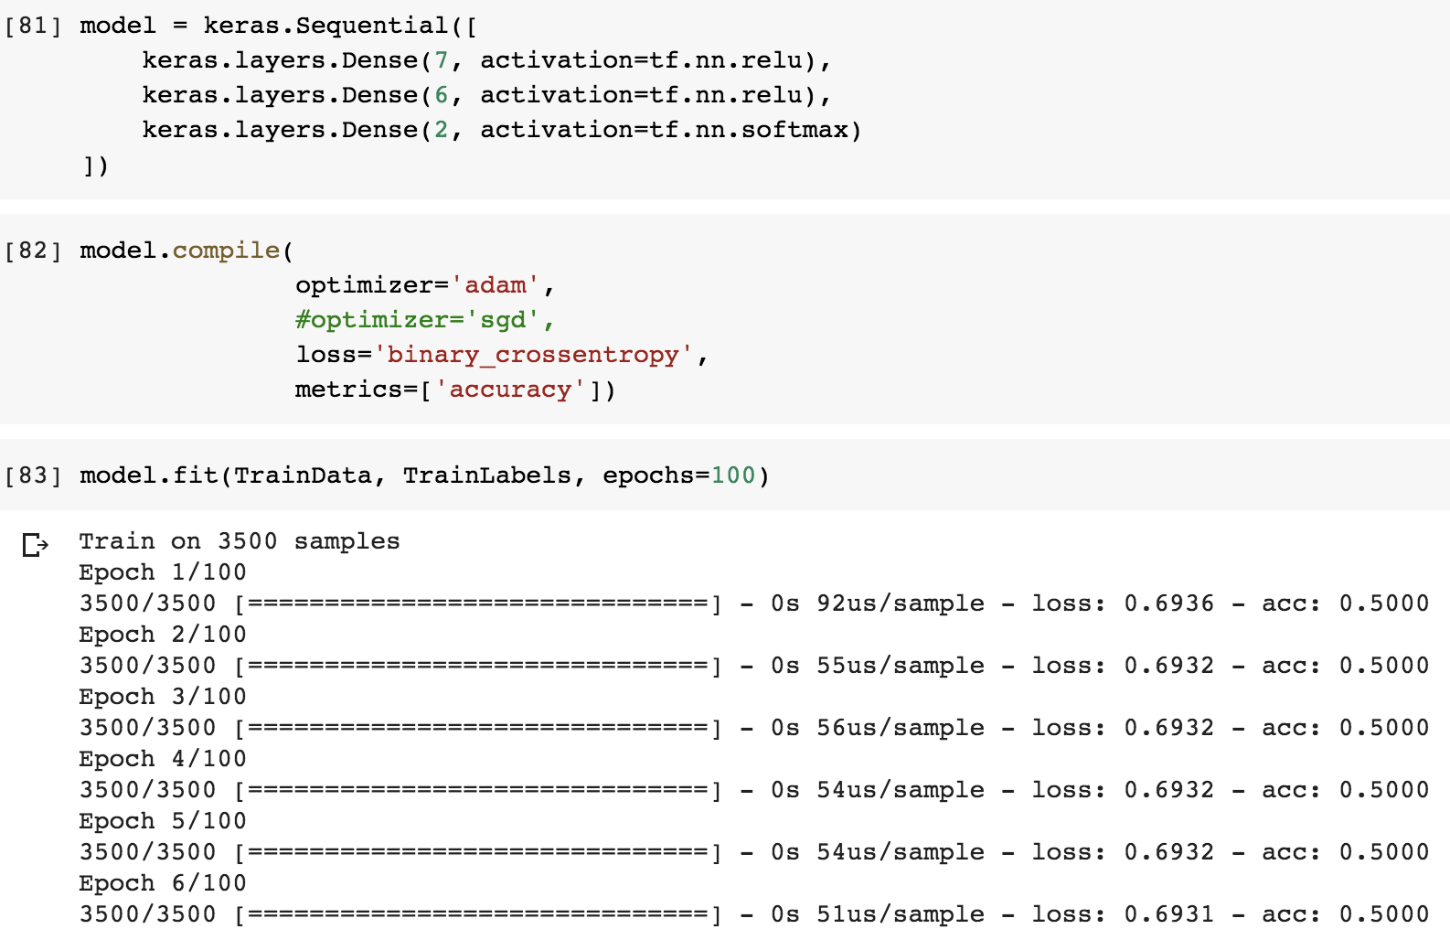
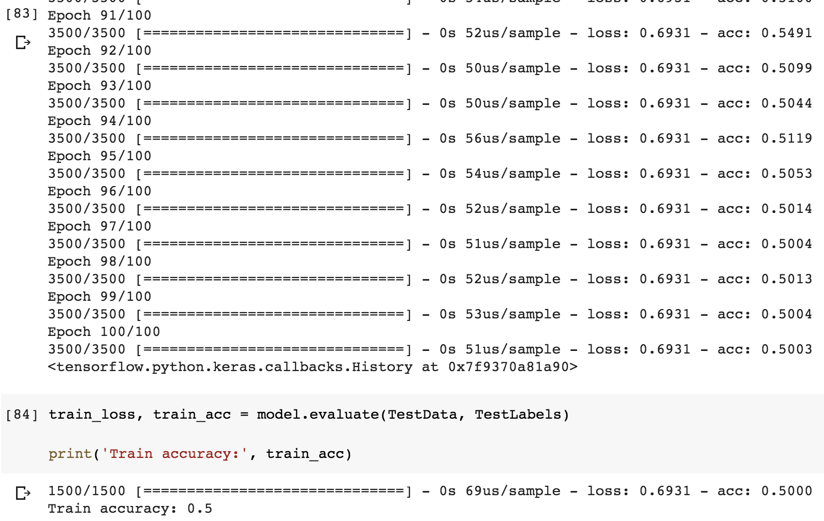
Appendix 2

Slide 6

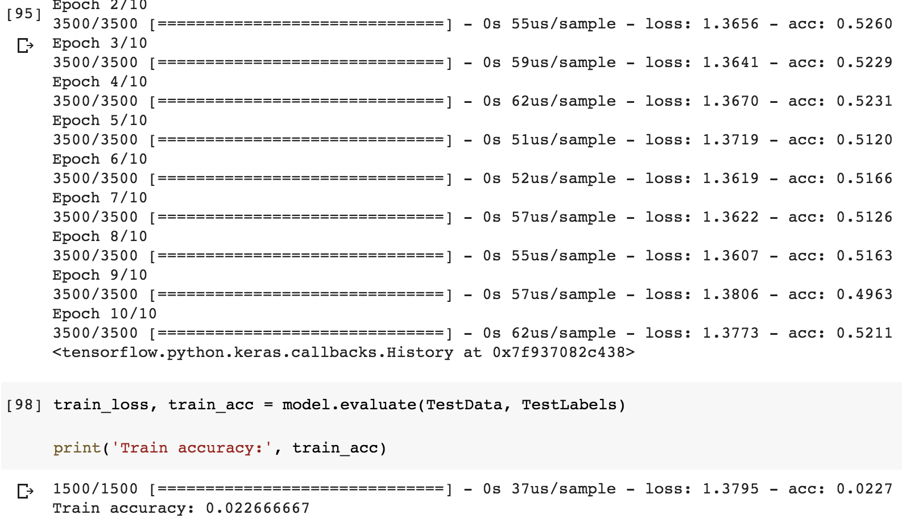
Appendix 3

Slide 7
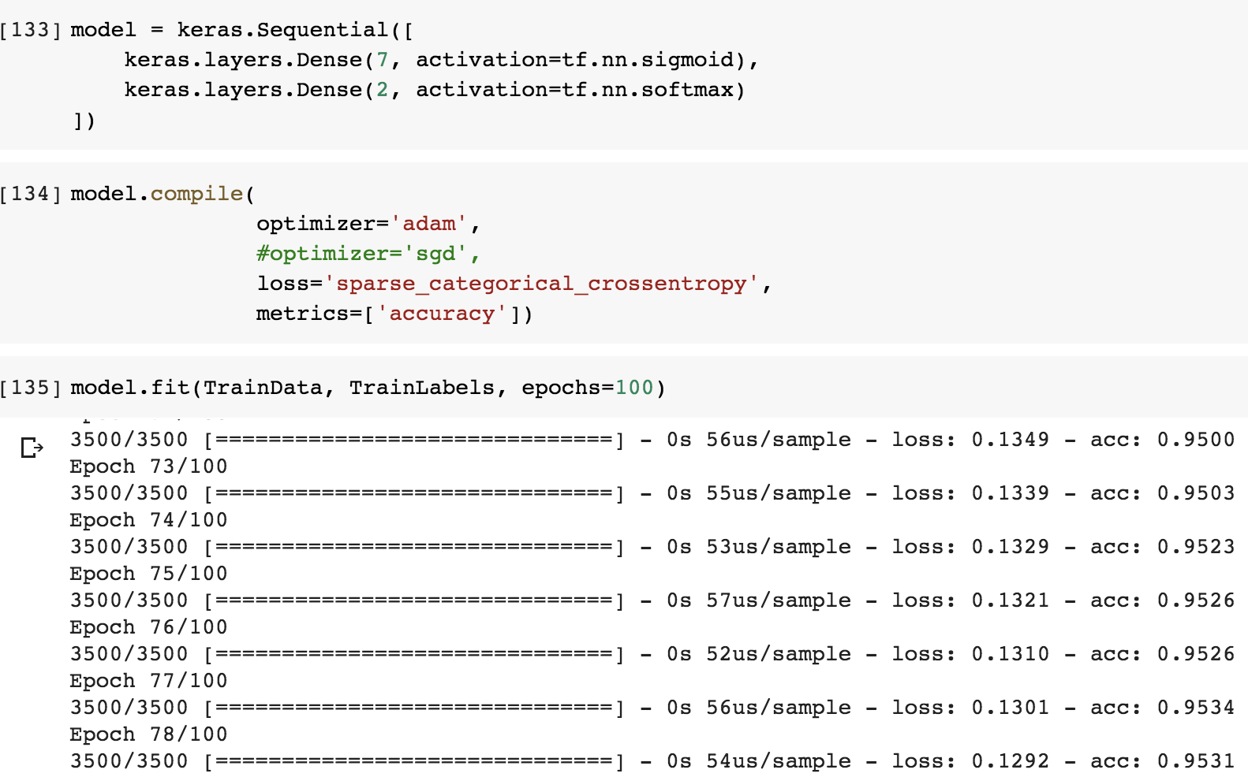
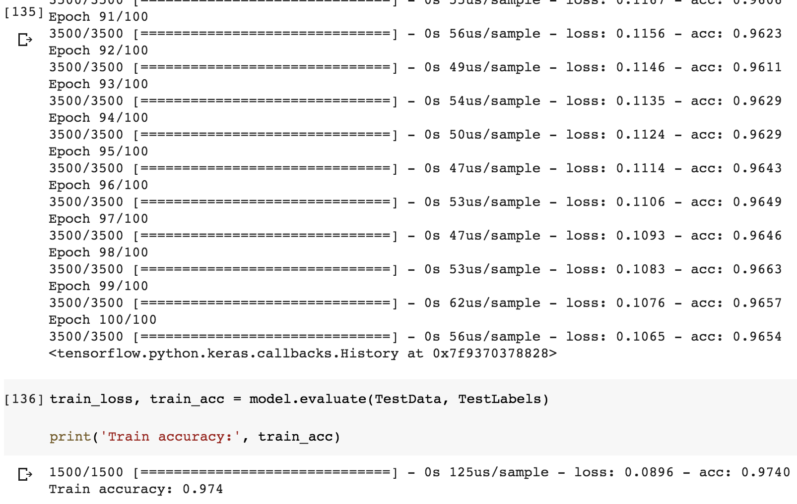
Appendix 4

Slide 8
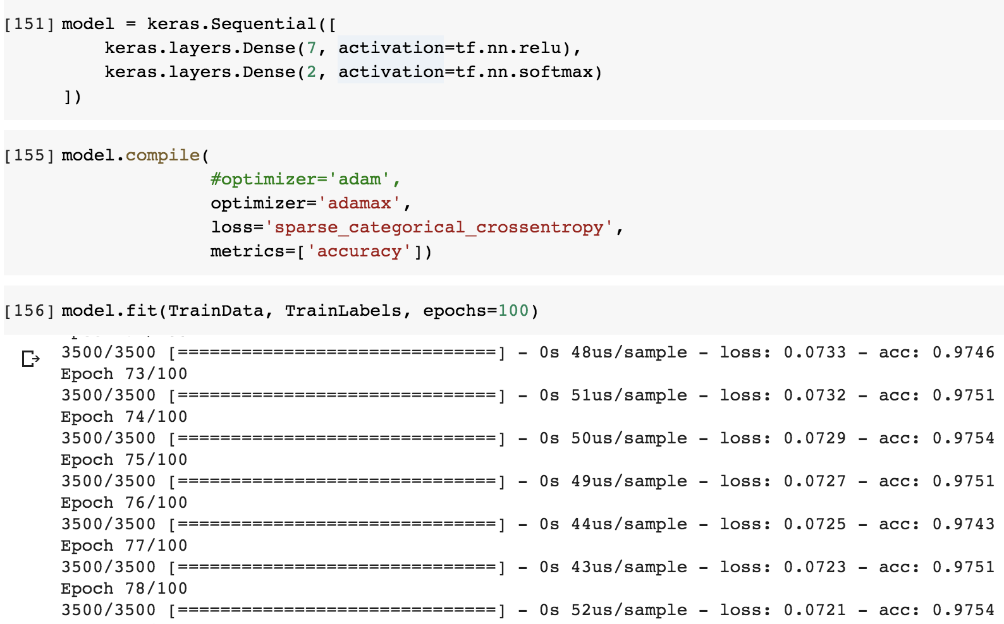
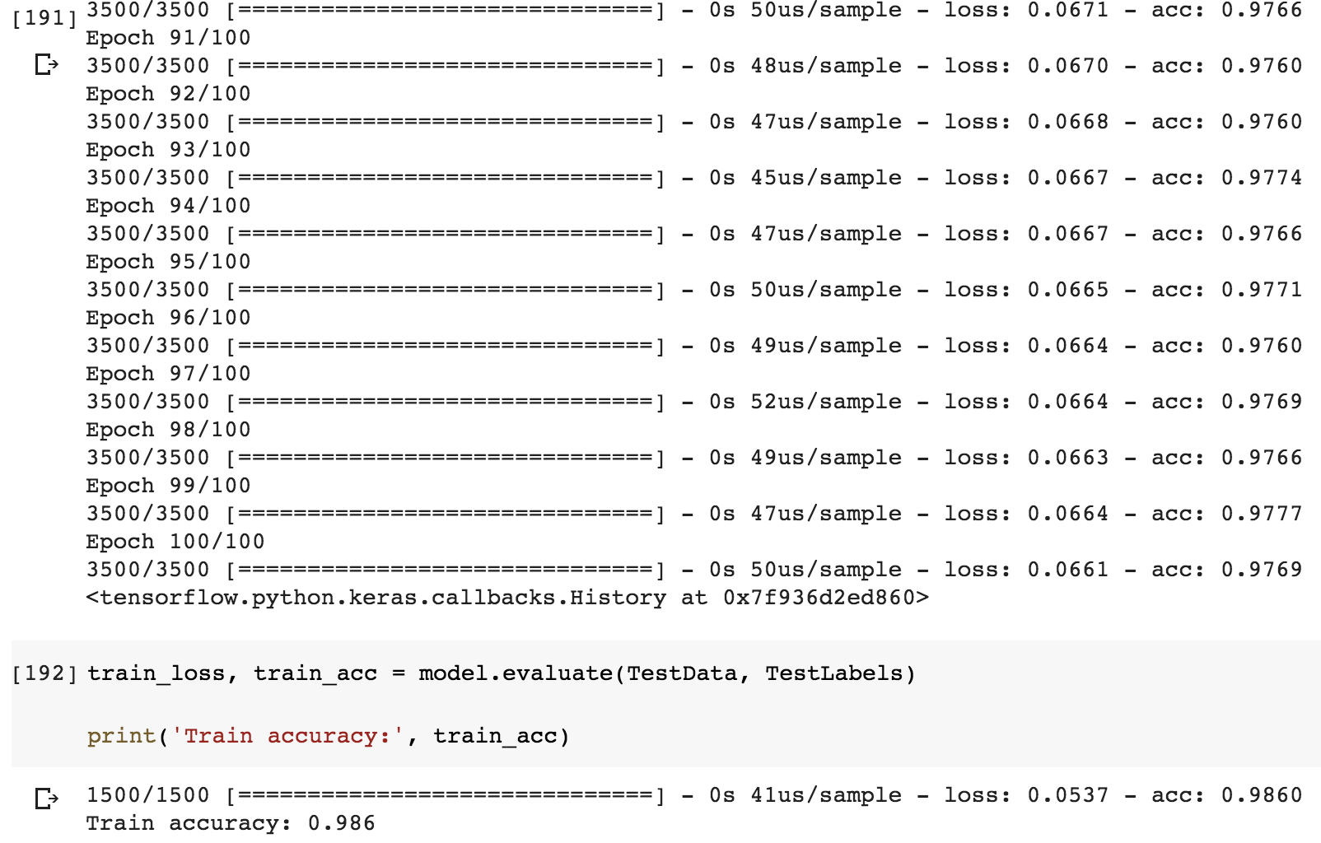
Appendix 5

Slide 9
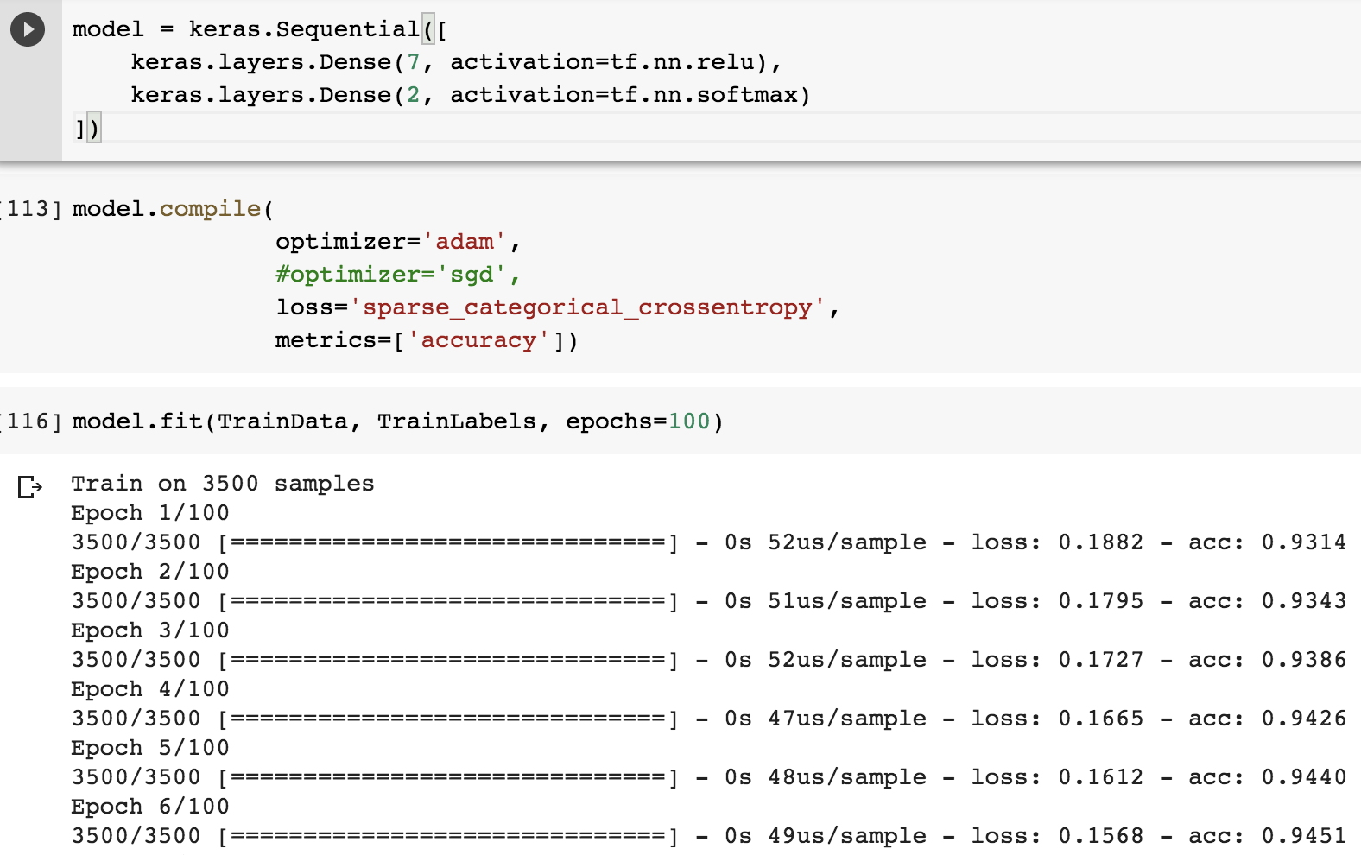
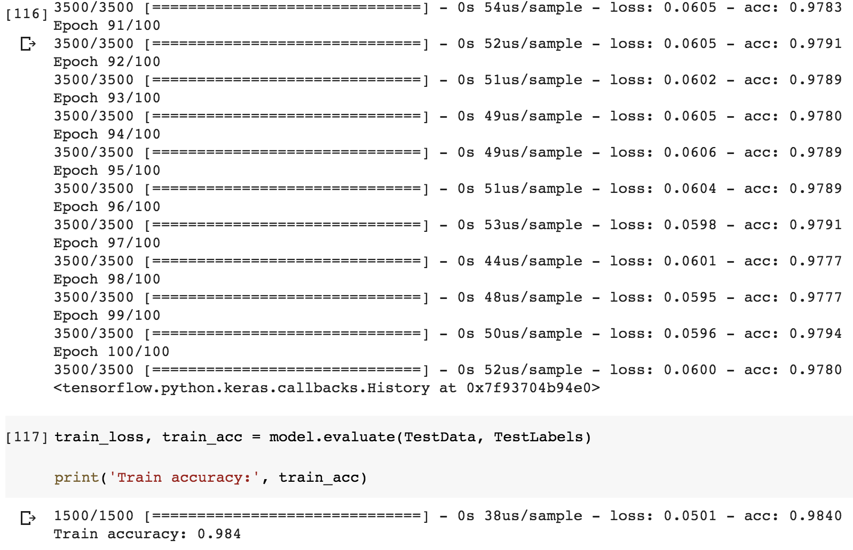
Appendix 6

Slide 10
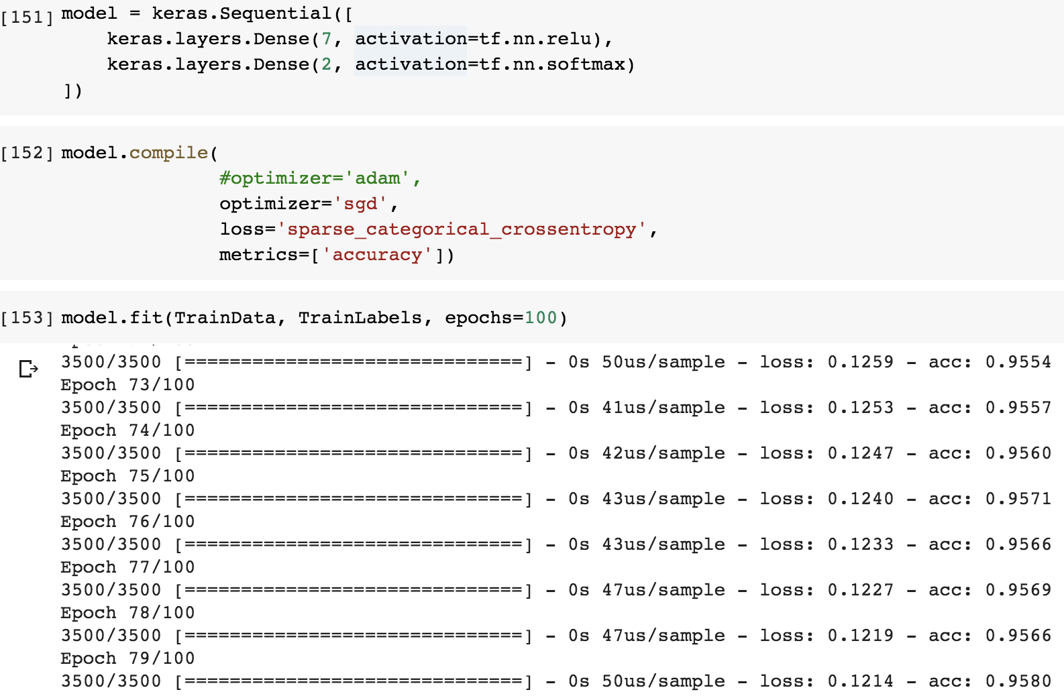
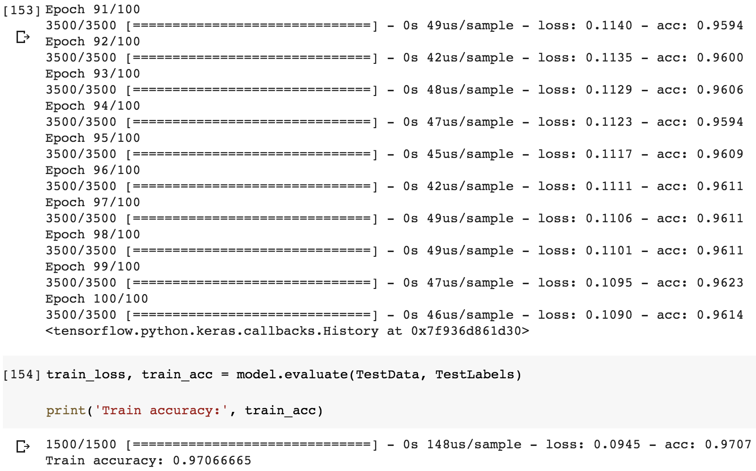
Appendix 7

Slide 11
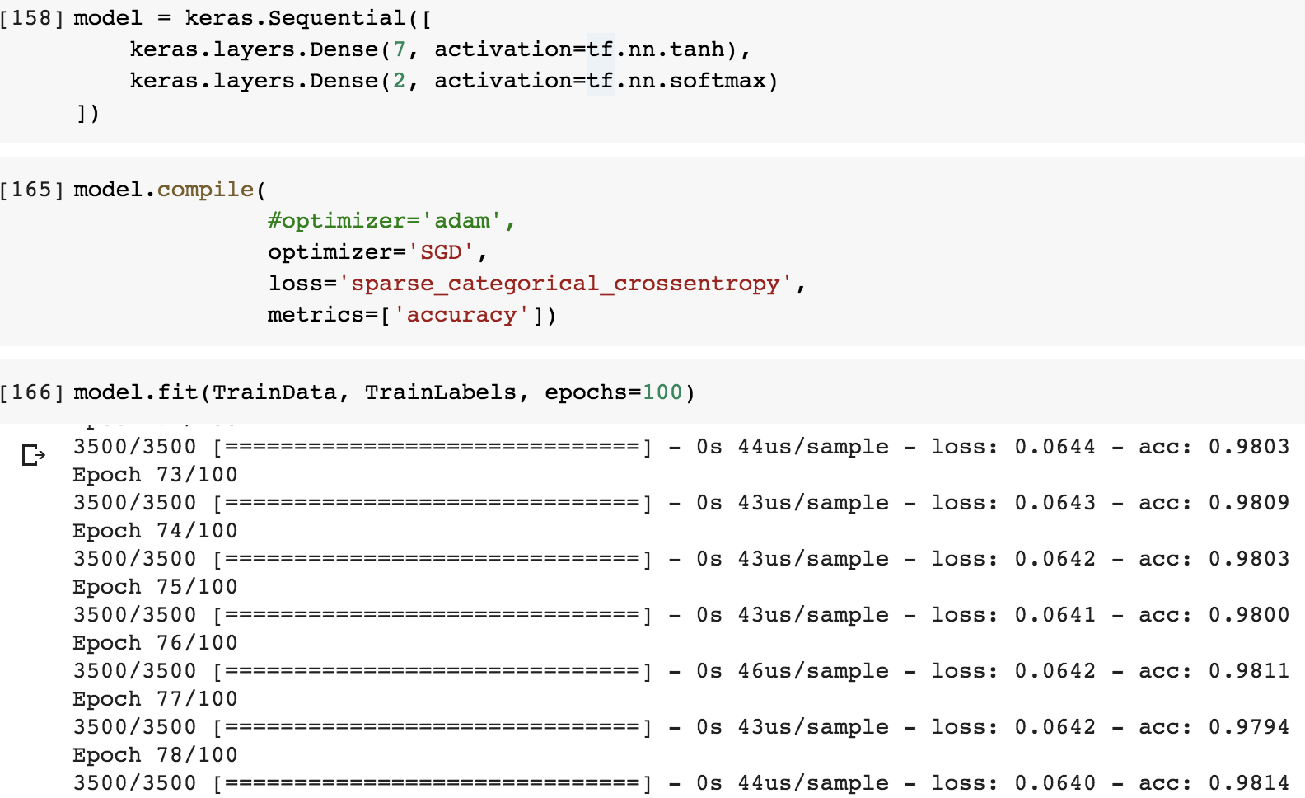
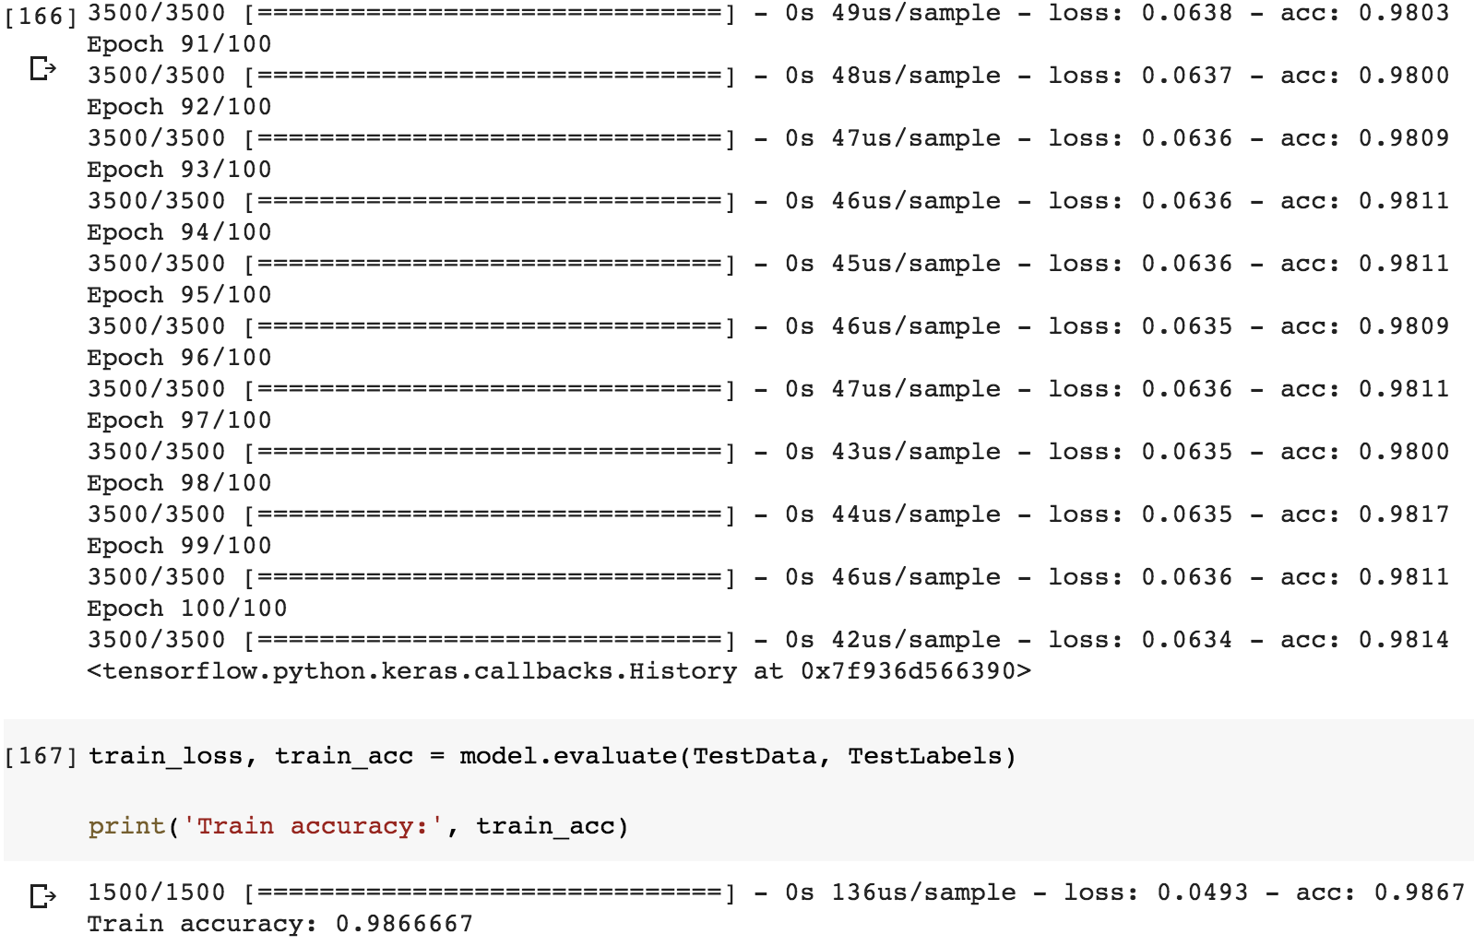
Appendix 8

Slide 12
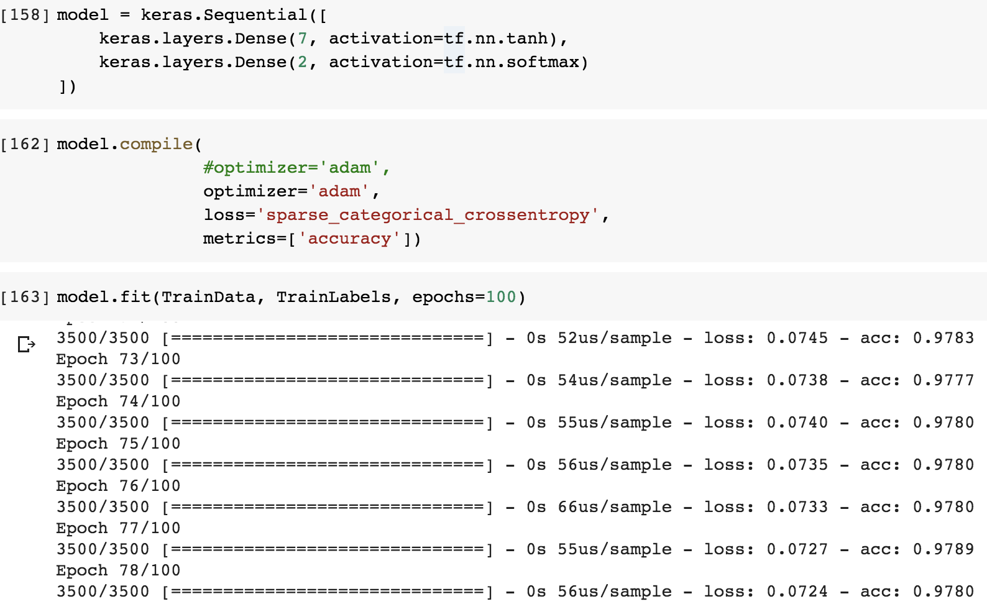

Appendix 9

